Slide 1
Module 2:
File Systems
Dr. Maria Valero

Slide 2
Module 2:
File Systems
LINUX
Dr. Maria Valero

Slide 3
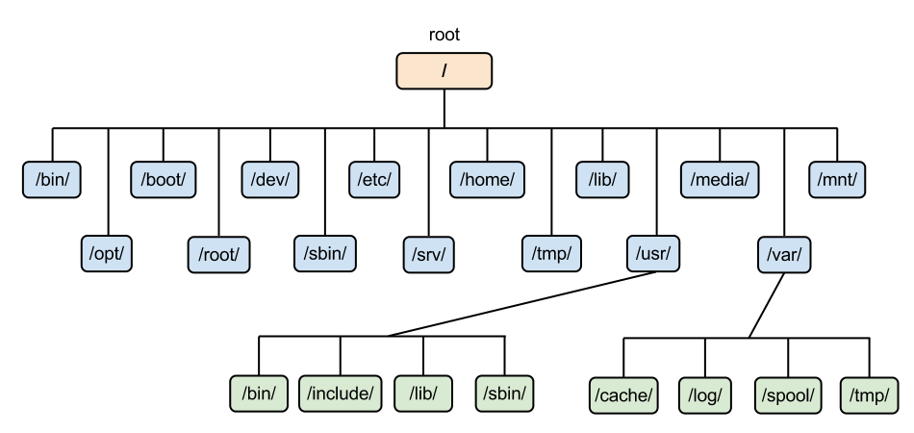
Linux File System

Slide 4
Directories
/ | Root directory. It contains the directories at the top level of the file structure | /mnt | Used to mount other temporary file systems, such as cdrom and floppy for the CD-ROM drive and floppy diskette drive, respectively
/bin | This is where the executable files are located. These files are available to all users | /proc | Contains all processes marked as a file by process number or other information that is dynamic to the system
/dev | These are device drivers | /tmp | Holds temporary files used between system boots
/etc | Supervisor directory commands, configuration files, disk configuration files, valid user lists, groups, ethernet, hosts, where to send critical messages | /usr | Used for miscellaneous purposes and can be used by many users. Includes administrative commands, shared files, library files, and others
/lib | Contains shared library files and sometimes other kernel-related files | /var | Typically contains variable-length files such as log and print files and any other type of file that may contain a variable amount of data
/boot | Contains files for booting the system | /sbin | Contains binary (executable) files, usually for system administration. For example, fdisk and ifconfig utilities
/home | Contains the home directory for users and other accounts | /kernel | Contain kernel files

Slide 5
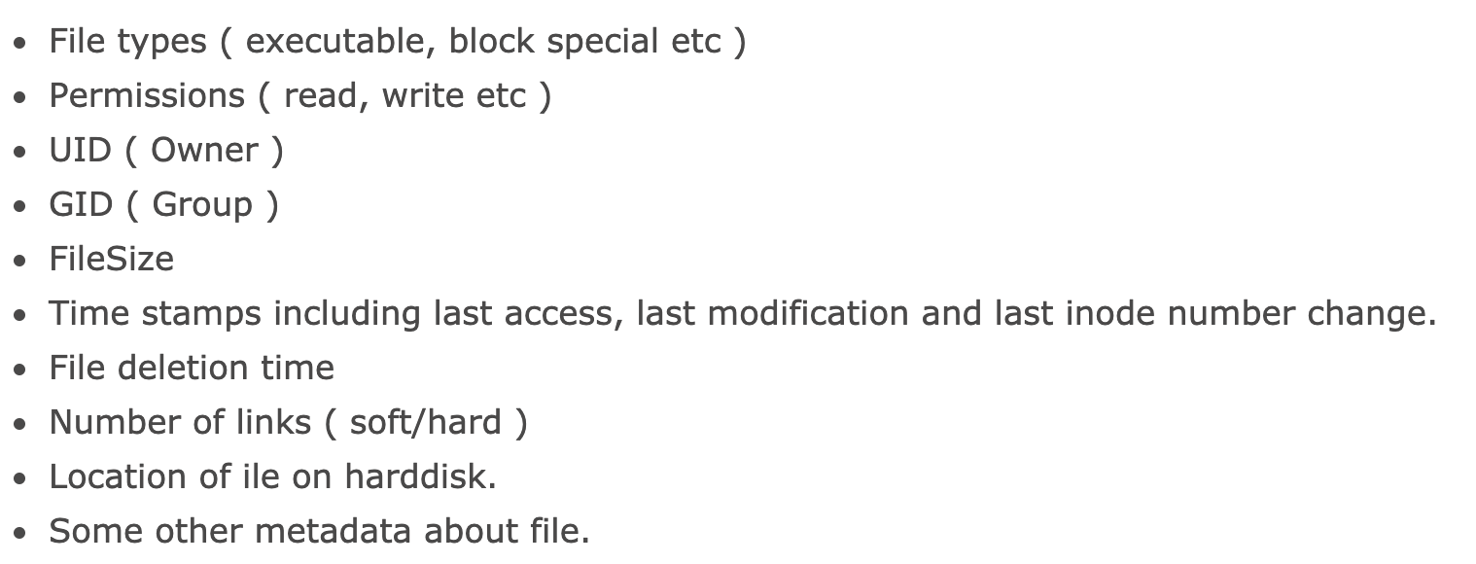
Inode
Inode number also called index number, it consists following attributes of any file:

Slide 6
Inode

Slide 7
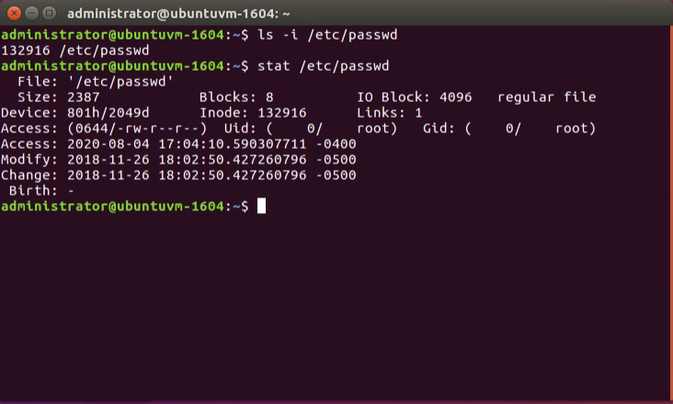
How do I see file Inode number?

Slide 8
Types of Files
Symbol | Meaning
- | Regular file
d | Directory
l | Link
c | Special file
s | Socket
p | Named pipe
b | Block device

Slide 9
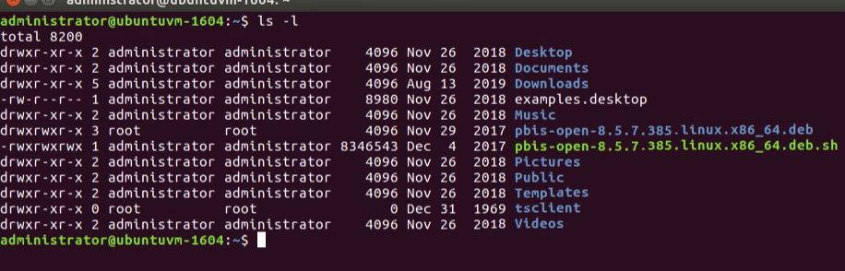
Command ls -l

Slide 10
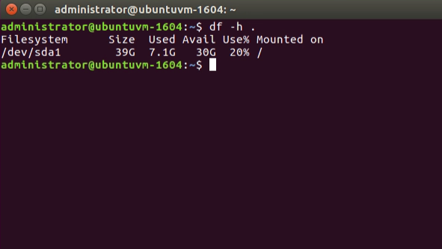
How can you find out which partition a directory is on?

Slide 11
Working with Directories

Slide 12
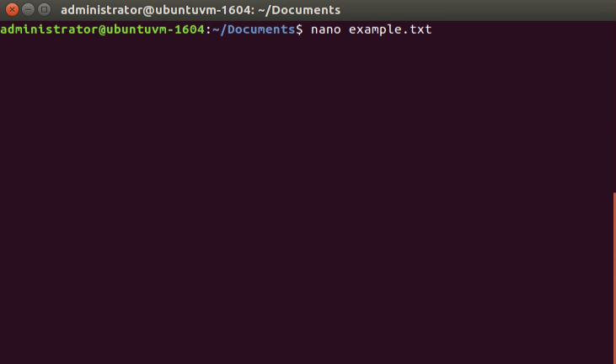
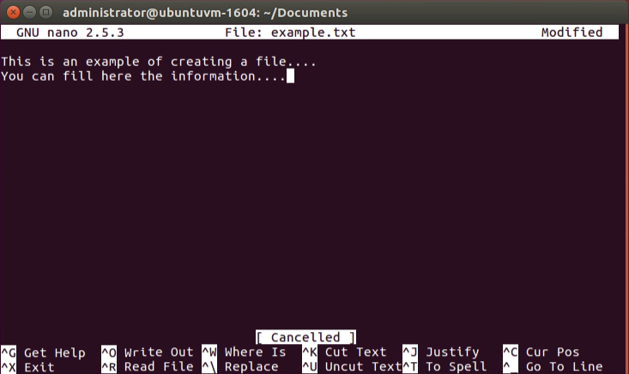
Use of nano command

Slide 13
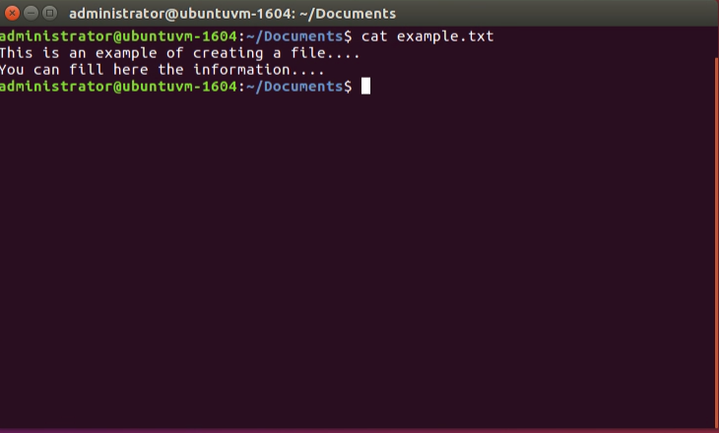
Use of cat command

Slide 14
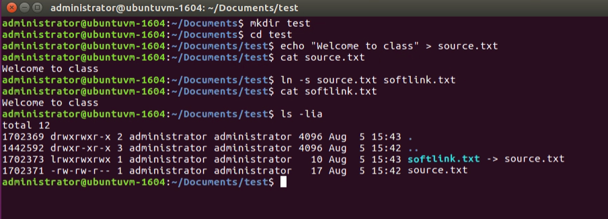
Symbolic (soft) links

Slide 15
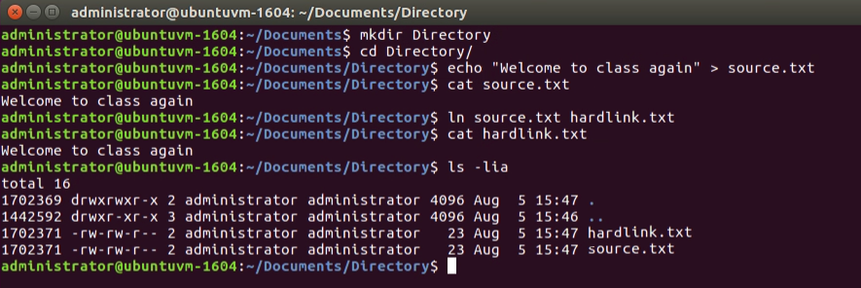
Hard Links

Slide 16
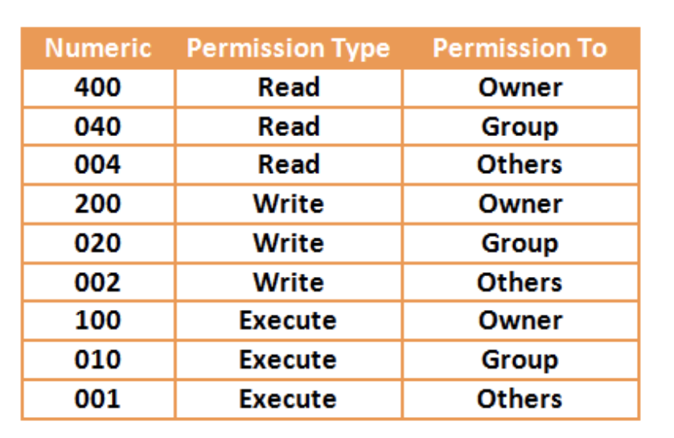
Permission
You can assign permissions to each file or directory

Slide 17
Permission of each file

Slide 18
chmod command

Slide 19
Module 2:
File Systems
Windows
Dr. Maria Valero

Slide 20
Windows File System
File system enables applications to store and retrieve files on storage devices.
File systems in Windows have the following storage component:
Volumes. (Collection of directories)
Directories. (Hierarchical collection of directories and files)
Files. (Logical grouping of related data)

Slide 21
FAT Overview
File Allocation Table (FAT)
Supported by Windows
Allocated in clusters
No organization to the FAT directory structure
No suitable for partitions > 200MB

Slide 22
HPFS Overview
High Performance File System (HPFS)
First introduced with OS/2 1.2 for larger hard drives
Maintains the directory organization as FAT, but adds automatic sorting of the directory based on filenames.
Holds more information than FAT (creation time, modification time of the file)
Allocates as much o a file in contiguous sectors as possible.

Slide 23
HPFS Overview

Slide 24
Super Block
Located in logical sector 16 and contains the pointer to the FNODE of the root directory.
Problem: If super block is lost or corrupted, the content of the partition is lost too.
Spare Block
Located in logical sector 17 and contains the “hot fixes” and the Spare Directory Block
When a bad sector is detected, the “hot fixes” entry is used to logically point to an existing good sector

Slide 25
Disadvantages of HPFS
Due to overhead, HPFS is not a very efficient choice for a volume of under 200MB
For volumes > 400MB there is a performance degradation
You cannot set security on HPFS under Window NT
Only support Window NT versions 3.1, 3.5 and 3.51

Slide 26
NFTS Overview
Organizes files into directories
There is no “special” objects on the disk and there is no dependence on the underlying hardware.
There is no special locations on the disk
Reliable for high end system and web servers
Remove limitations of the FAT and HPFS file systems
POSIX support

Slide 27
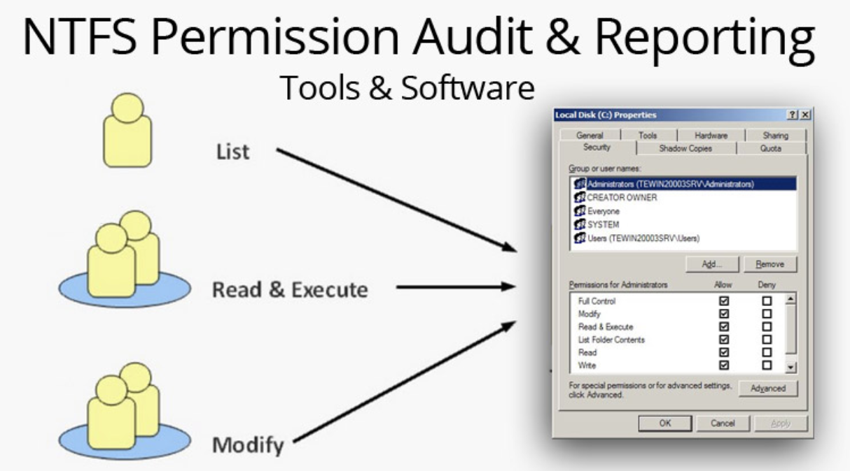
NFTS Overview

Slide 28
NFTS Overview

Slide 29
NFTS Naming Conventions
File and directory names can be up to 255 characters long, including extensions
NTFS make NO distinction of filenames based on case
Names can content any characters except
? “ / \ < > * | :

Slide 30
NFTS Advantages
Best for use on volumes of about 400MB or more
The recoverability design into NTFS is such that a user should never have to run any sort of disk repair utility on an NTFS partition
NFTS Disadvantages
Currently there is no file encryption built into NTFS

