Slide 1
Module 3:
Shell Scripting
Dr. Maria Valero

Slide 2
Agenda
Introduction
UNIX/LINUX and Shell
UNIX Commands and Utilities
Basic Shell Scripting Structure
Shell Programming
Variable
Operators
Logic Structures
Examples of Application in Research Computing
Hands-on Exercises

Slide 3
What is a “Shell”
The “Shell” is simply another program on top of the kernel which provides a basic human-OS interface.
It is a command interpreter
Built on top of the kernel
Enables users to run services provided by the UNIX OS
In its simplest form, a series of commands in a file is a shell program that saves having to retype commands to perform common tasks.
How to know what shell you use
echo $SHELL
Shell
user
user
OS
user

Slide 4
UNIX Shells
sh Bourne Shell (Original Shell) (Steven Bourne of AT&T)
bash Bourne Again Shell (GNU Improved Bourne Shell)
csh C-Shell (C-like Syntax)(Bill Joy of Univ. of California)
ksh Korn-Shell (Bourne+some C-shell)(David Korn of AT&T)
tcsh Turbo C-Shell (More User Friendly C-Shell).
To check shell:
$ echo $SHELL (shell is a pre-defined variable)
To switch shell:
$ exec shellname (e.g., $ exec bash or simply type $ bash)
You can switch from one shell to another by just typing the name of the shell. exit return you back to previous shell.

Slide 5
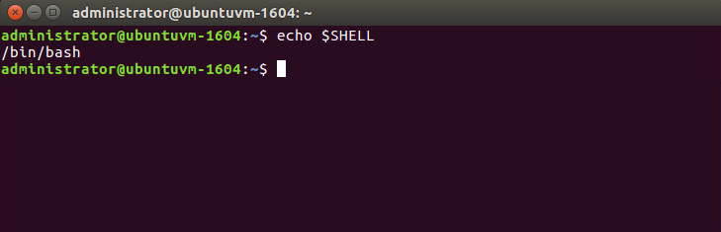
UNIX Shell Example

Slide 6
Which shell to use?
sh ( Bourne shell) was considered better for programming
csh (C-Shell ) was considered better for interactive work.
tcsh and korn were improvements on c-shell and bourne shell respectively.
bash is largely compatible with sh and also has many of the nice features of the other shells
On many systems such as our LINUX clusters sh is symbolically linked to bash, /bin/sh -> /bin/bash
We recommend that you use sh/bash for writing new shell scripts but learn csh/tcsh to understand existing scripts.
Many, if not all, scientific applications require csh/tcsh environment (GUI, Graphics Utility Interface)
All Linux versions use the Bash shell (Bourne Again Shell) as the default shell
Bash/Bourn/ksh/sh prompt: $
All UNIX system include C shell and its predecessor Bourne shell.
Csh/tcsh prompt: %

Slide 7
What is Shell Script
A shell script is a script written for the shell
Two key ingredients
UNIX/LINUX commands
Shell programming syntax

Slide 8
A Shell Script Example
#!/bin/sh
`ls -l *.log| awk '{print $8}' |sed 's/.log//g' > file_list`
cat file_list|while read each_file
do
babel -ig03 $each_file".log" -oxyz $each_file".xyz“
echo '# nosymmetry integral=Grid=UltraFine scf=tight rhf/6-311++g** pop=(nbo,chelpg)'>head
echo ' ' >>head
echo ''$each_file' opt pop nbo chelp aim charges ' >> head
echo ' ' >>head
echo '0 1 ' >>head
`sed '1,2d' $each_file.xyz >junk`
input=./$each_file".com"
cat head > $input
cat junk >> $input
echo ' ' >> $input
done
/bin/rm ./junk ./head ./file_list

Slide 9
Unix/Linux Commands
File Management and Viewing
Filesystem Management
Help, Job/Process Management
Network Management
User Management
Printing and Programming
Document Preparation
Miscellaneous
To understand the working of the command and possible options us (man command)
Using the GNU Info System (info command)
Listing a description of a program (whatis command)
Many tools have a long-style option, “--help”, that outputs usage information about the tool, including the options and arguments the tool takes. Ex: whoami --help

Slide 10
File and Directory Management
cd Change the current directory. With no arguments "cd" changes to the users home directory. (cd <directory path>)
chmod Change the file permissions.
Ex: chmod 751 myfile : change the file permissions to rwx for owner, rx for group and x for others (x=1,r=4,w=2)
Ex: chmod go=+r myfile : Add read permission for the group and others (character meanings u- user, g-group, o-other, + add permission,-remove,r-read,w-write,x-exe) Ex: chmod +s myfile : Setuid bit on the file which allows the program to run with user or group privileges of the file.
chown Change owner.
Ex: chown <owner1> <filename> : Change ownership of a file to owner1.
chgrp Change group.
Ex: chgrp <group1> <filename> : Change group of a file to group1.
cp Copy a file from one location to another.
Ex: cp file1 file2 : Copy file1 to file2; Ex: cp –R dir1 dir2 : Copy dir1 to dir2

Slide 11
File and Directory Management
ls List contents of a directory.
Ex: ls, ls –l , ls –al, ls –ld, ls –R
mkdir Make a directory.
Ex: mkdir <directory name> : Makes a directory
Ex mkdir –p /www/chache/var/log will create all the directories starting from www.
mv Move or rename a file or directory.
Ex: mv <source> <destination>
find Find files (find <start directory> -name <file name> -print)
Ex: find /home –name readme -print
Search for readme starting at home and output full path, “/home" = Search starting at the home directory and proceed through all its subdirectories; "-name readme" = Search for a file named readme "-print" = Output the full path to that file
locate File locating program that uses the slocate database.
Ex: locate –u to create the database,
locate <file/directory> to find file/directory

Slide 12
File and Directory Management
File compression, backing up and restoring
compress Compress data.
uncompress Expand data.
cpio Can store files on tapes. to/from archives.
gzip - zip a file to a gz file.
gunzip - unzip a gz file.
tar Archives files and directories. Can store files and directories on tapes.
Ex: tar -zcvf <destination> <files/directories> - Archive copy groups of files. tar –zxvf <compressed file> to uncompress
zip – Compresses a file to a .zip file.
unzip – Uncompresses a file with .zip extension.
cat View a file
Ex: cat filename
cmp Compare two files.
cut Remove sections from each line of files.

Slide 13
File and Directory Management
diff Show the differences between files
Ex: diff file1 file2 : Find differences between file1 & file2.
echo Display a line of text.
grep List all files with the specified expression. (grep pattern <filename/directorypath>)
Ex: ls –l |grep sidbi : List all lines with a sidbi in them.
Ex: grep " R " : Search for R with a space on each side
sleep Delay for a specified amount of time.
sort Sort a file alphabetically.
uniq Remove duplicate lines from a sorted file.
wc Count lines, words, characters in a file. (wc –c/w/l <filename>).
sed stream editor, extremely powerful!
awk an extremely versatile programming language for working on files

Slide 14
Useful Commands in Scripting
grep
Pattern searching
Example: grep ‘boo’ filename
sed
Text editing
Example: sed 's/XYZ/xyz/g' filename
awk
Pattern scanning and processing
Example: awk ‘{print $4, $7}’ filename

Slide 15
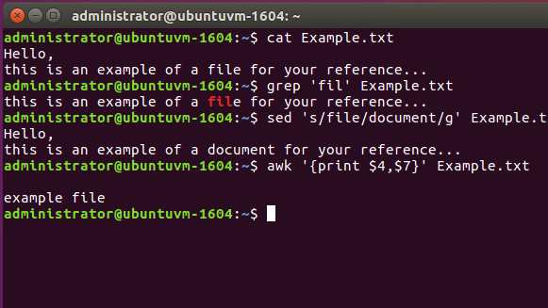
Examples of cat, grep, sed and awk

Slide 16
Shell Scripting
Start vi scriptfilename.sh with the line
#!/bin/sh
All other lines starting with # are comments.
make code readable by including comments
Tell Unix that the script file is executable
$ chmod u+x scriptfilename.sh
$ chmod +x scriptfilename.sh
Execute the shell-script
$ ./scriptfilename.sh

Slide 17
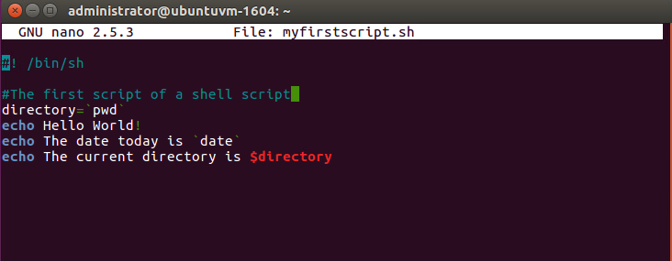
My first shell script

Slide 18
My first shell script

Slide 19
Shell Scripts
Text files that contain sequences of UNIX commands , created by a text editor
No compiler required to run a shell script, because the UNIX shell acts as an interpreter when reading script files
After you create a shell script, you simply tell the OS that the file is a program that can be executed, by using the chmod command to change the files’ mode to be executable
Shell programs run less quickly than compiled programs, because the shell must interpret each UNIX command inside the executable script file before it is executed

Slide 20
Commenting
Lines starting with # are comments except the very first line where #! indicates the location of the shell that will be run to execute the script.
On any line characters following an unquoted # are considered to be comments and ignored.
Comments are used to;
Identify who wrote it and when
Identify input variables
Make code easy to read
Explain complex code sections
Version control tracking
Record modifications

Slide 21
Quote Characters
There are three different quote characters with different behaviour. These are:
“ : double quote, weak quote. If a string is enclosed in “ ” the references to variables (i.e $variable ) are replaced by their values. Also back-quote and escape \ characters are treated specially.
‘ : single quote, strong quote. Everything inside single quotes are taken literally; nothing is treated as special.
` : back quote. A string enclosed as such is treated as a command and the shell attempts to execute it. If the execution is successful, the primary output from the command replaces the string.
Example: echo “Today is:” `date`

Slide 22
Echo
Echo command is well appreciated when trying to debug scripts.
Syntax : echo {options} string
Options: -e : expand \ (back-slash ) special characters
-n : do not output a new-line at the end.
String can be a “weakly quoted” or a ‘strongly quoted’ string. In the weakly quoted strings the references to variables are replaced by the value of those variables before the output.
As well as the variables some special backslash_escaped symbols are expanded during the output. If such expansions are required the –e option must be used.

Slide 23
User Input during Shell Script Execution
As shown on the hello script input from the standard input location is done via the read command.
Example
echo "Please enter three filenames:”
read filea fileb filec
echo “These files are used:$filea $fileb $filec”
Each read statement reads an entire line. In the above example if there are less than 3 items in the response the trailing variables will be set to blank ‘ ‘.
Three items are separated by one space.

Slide 24
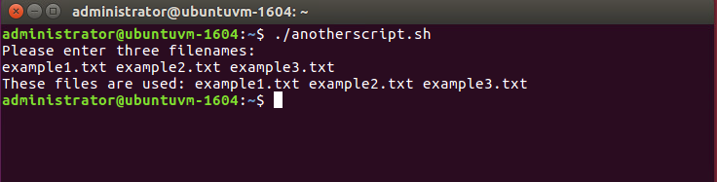
User Input during Shell Script Execution

Slide 25
Hello script exercise (cont’)
The following script ask the user to enter his name and displays a personalized hello
#!/bin/sh
echo “Who am I talking to?”
read user_name
echo “Hello $user_name”
Try replacing “ with ‘ in the last line to see what happens

Slide 26
Debugging your shell script
Generous use of the echo command will help.
Run script with the –x parameter.
E.g. sh –x ./myscript
or set –o xtrace before running the script.
These options can be added to the first line of the script where the shell is defined.
e.g. #!/bin/sh -xv

Slide 27
Shell Programming
Programming features of the UNIX/LINUX shell:
Shell variables: Your scripts often need to keep values in memory for later use. Shell variables are symbolic names that can access values stored in memory
Operators: Shell scripts support many operators, including those for performing mathematical operations
Logic structures: Shell scripts support sequential logic (for performing a series of commands), decision logic (for branching from one point in a script to another), looping logic (for repeating a command several times), and case logic (for choosing an action from several possible alternatives)

Slide 28
Variables
Variables are symbolic names that represent values stored in memory
Three different types of variables
Global Variables: Environment and configuration variables, capitalized, such as HOME, PATH, SHELL, USERNAME, and PWD.
When you login, there will be a large number of global System variables that are already defined. These can be freely referenced and used in your shell scripts.
Local Variables
Within a shell script, you can create as many new variables as needed. Any variable created in this manner remains in existence only within that shell.
Special Variables
Reversed for OS, shell programming, etc. such as positional parameters $0, $1 …

Slide 29
A few global (environment) variables
SHELL | Current shell
DISPLAY | Used by X-Windows system to identify the display
HOME | Fully qualified name of your login directory
PATH | Search path for commands
MANPATH | Search path for <man> pages
PS1 & PS2 | Primary and Secondary prompt strings
USER | Your login name
TERM | terminal type
PWD | Current working directory

Slide 30
Referencing Variables
Variable contents are accessed using ‘$’:
e.g. $ echo $HOME
$ echo $SHELL
To see a list of your environment variables:
$ printenv
or:
$ printenv | more

Slide 31
Defining Local Variables
As in any other programming language, variables can be defined and used in shell scripts.
Unlike other programming languages, variables in Shell Scripts are not typed.
Examples :
a=1234 # a is NOT an integer, a string instead
b=$a+1 # will not perform arithmetic but be the string ‘1234+1’
b=`expr $a + 1 ` # will perform arithmetic so b is 1235 now.
Note : +,-,/,*,**, % operators are available.
b=abcde # b is string
b=‘abcde’ # same as above but much safer.
b=abc def # will not work unless ‘quoted’
b=‘abc def’ # i.e. this will work.
IMPORTANT NOTE: DO NOT LEAVE SPACES AROUND THE =

Slide 32
Referencing variables --curly bracket
Having defined a variable, its contents can be referenced by the $ symbol. E.g. ${variable} or simply $variable. When ambiguity exists $variable will not work. Use ${ } the rigorous form to be on the safe side.
Example:
a=‘abc’
b=${a}def # this would not have worked without the{ } as
#it would try to access a variable named adef

Slide 33
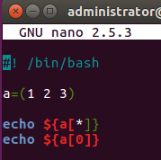
Variable List/Array
To create lists (array) – round bracket
$ set Y = (UNL 123 CS251)
To set a list element – square bracket
$ set Y[2] = HUSKER
To view a list element:
$ echo $Y[2]
Example:
#!/bin/bash
a=(1 2 3)
echo ${a[*]}
echo ${a[0]}

Slide 34
Positional Parameters
When a shell script is invoked with a set of command line parameters each of these parameters are copied into special variables that can be accessed.
$0 This variable that contains the name of the script
$1, $2, ….. $n 1st, 2nd 3rd command line parameter
$# Number of command line parameters
$$ process ID of the shell
$@ same as $* but as a list one at a time (see for loops later )
$? Return code ‘exit code’ of the last command
Shift command: This shell command shifts the positional parameters by one towards the beginning and drops $1 from the list. After a shift $2 becomes $1 , and so on … It is a useful command for processing the input parameters one at a time.
Example:
Invoke : ./myscript one two buckle my shoe
During the execution of myscript variables $1 $2 $3 $4 and $5 will contain the values one, two, buckle, my, shoe respectively.

Slide 35
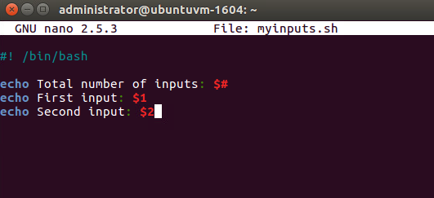
Variables

Slide 36
Shell Programming
Programming features of the UNIX shell:
Shell variables
Operators
Logic structures

Slide 37
Shell Operators
The Bash/Bourne/ksh shell operators are divided into three groups:
defining and evaluating operators,
arithmetic operators, and
redirecting and piping operators

Slide 38
Shell Operators
A shell variable take on the generalized form variable=value (except in the C shell).
$ set x=37; echo $x
37
$ unset x; echo $x
x: Undefined variable.
You can set a pathname or a command to a variable or substitute to set the variable.
$ set mydir=`pwd`; echo $mydir

Slide 39
Pipes & Redirecting
Piping: An important early development in Unix , a way to pass the output of one tool to the input of another.
$ who | wc −l
By combining these two tools, giving the wc command the output of who, you can build a new command to list the number of users currently on the system
Redirecting via angle brackets: Redirecting input and output follows a similar principle to that of piping except that redirects work with files, not commands.
tr '[a-z]' '[A-Z]' < $in_file > $out_file
The command must come first, the in_file is directed in by the less_than sign (<) and the out_file is pointed at by the greater_than sign (>).

Slide 40
Arithmetic Operators
expr supports the following operators:
arithmetic operators: +,-,*,/,%
comparison operators: <, <=, ==, !=, >=, >
boolean/logical operators: &, |
parentheses: (, )
precedence is the same as C, Java

Slide 41
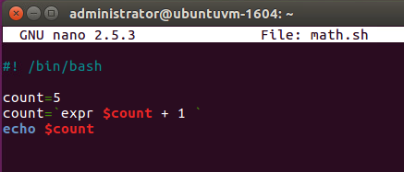
Arithmetic Operators

Slide 42
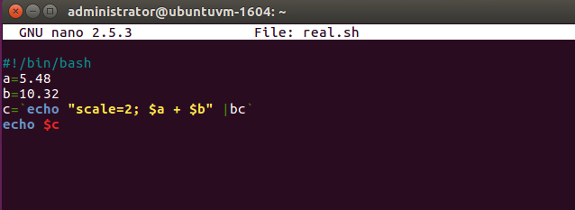
Arithmetic Operators

Slide 43
Arithmetic Operations in Shell Script
var++ ,var-- , ++var , --var | post/pre increment/decrement
+ , - | add subtract
* , / , % | multiply/divide, remainder
** | power of
! , ~ | logical/bitwise negation
& , | | bitwise AND, OR
&& || | logical AND, OR

Slide 44
Shell Logic Structures
The four basic logic structures needed for program development are:
Sequential logic: to execute commands in the order in which they appear in the program
Decision logic: to execute commands only if a certain condition is satisfied
Looping logic: to repeat a series of commands for a given number of times
Case logic: to replace “if then/else if/else” statements when making numerous comparisons

Slide 45
Conditional Statements
The most general form of the if construct is;
if command executes successfully
then
execute command
elif this command executes successfully
then
execute this command
and execute this command
else
execute default command
fi
However- elif and/or else clause can be omitted.

Slide 46
Examples
SIMPLE EXAMPLE:
if date | grep “Fri”
then
echo “It’s Friday!”
fi
FULL EXAMPLE:
if [ “$1” == “Monday” ]
then
echo “The typed argument is Monday.”
elif [ “$1” == “Tuesday” ]
then
echo “Typed argument is Tuesday”
else
echo “Typed argument is neither Monday nor Tuesday”
fi
# Note: = or == will both work in the test but == is better for readability.

Slide 47
Tests
String and numeric comparisons used with test or [[ ]] which is an alias for test and also [ ] which is another acceptable syntax
string1 = string2 True if strings are identical
String1 == string2 …ditto….
string1 !=string2 True if strings are not identical
string Return 0 exit status (=true) if string is not null
-n string Return 0 exit status (=true) if string is not null
-z string Return 0 exit status (=true) if string is null
int1 –eq int2 Test identity
int1 –ne int2 Test inequality
int1 –lt int2 Less than
int1 –gt int2 Greater than
int1 –le int2 Less than or equal
int1 –ge int2 Greater than or equal

Slide 48
Combining test with logical operations || (or) && (and)
Syntax: if cond1 && cond2 || cond3 … An alternative form is to use a compound statement using the –a and –o keywords, i.e.
if cond1 –a cond22 –o cond3 …
Where cond1,2,3 .. Are either commands returning a a value or test conditions of the form [ ] or test …
Examples:
if date | grep “Fri” && `date +’%H’` -gt 17
then
echo “It’s Friday, it’s home time!!!”
fi
if [ “$a” –lt 0 –o “$a” –gt 100 ] # note the spaces around ] and [
then
echo “ limits exceeded”
fi

Slide 49
File enquiry operations
-d file Test if file is a directory
-f file Test if file is not a directory
-s file Test if the file has non zero length
-r file Test if the file is readable
-w file Test if the file is writable
-x file Test if the file is executable
-o file Test if the file is owned by the user
-e file Test if the file exists
-z file Test if the file has zero length
All these conditions return true if satisfied and false otherwise.

Slide 50
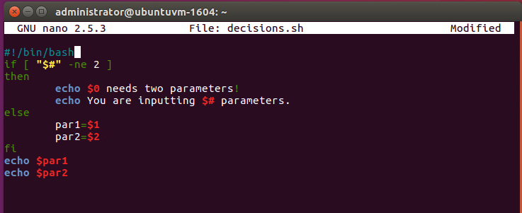
Decision logic

Slide 51
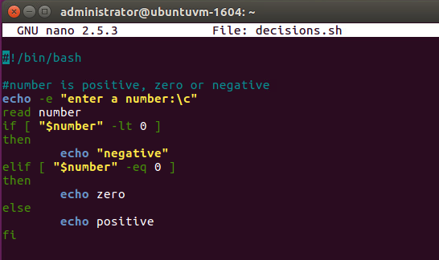
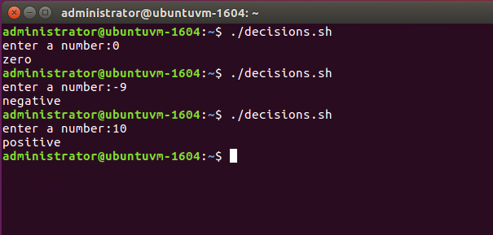
Another example of decisions

Slide 52
Loops
Loop is a block of code that is repeated a number of times.
The repeating is performed either a pre-determined number of times determined by a list of items in the loop count ( for loops ) or until a particular condition is satisfied ( while and until loops)
To provide flexibility to the loop constructs there are also two statements namely break and continue are provided.

Slide 53
For loops
Syntax:
for arg in list
do
command(s)
...
done
Where the value of the variable arg is set to the values provided in the list one at a time and the block of statements executed. This is repeated until the list is exhausted.
Example:
for i in 3 2 5 7
do
echo " $i times 5 is $(( $i * 5 )) "
done

Slide 54
While Loop
A different pattern for looping is created using the while statement
The while statement best illustrates how to set up a loop to test repeatedly for a matching condition
The while loop tests an expression in a manner similar to the if statement
As long as the statement inside the brackets is true, the statements inside the do and done statements repeat

Slide 55
While Loop
Syntax:
while this_command_execute_successfully
do
this command
and this command
done
EXAMPLE:
while test "$i" -gt 0 # can also be while [ $i > 0 ]
do
i=`expr $i - 1`
done

Slide 56
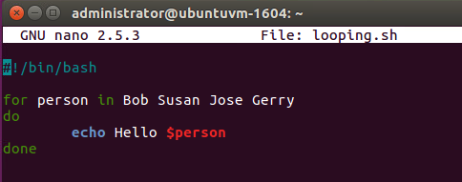
Looping Logic

Slide 57
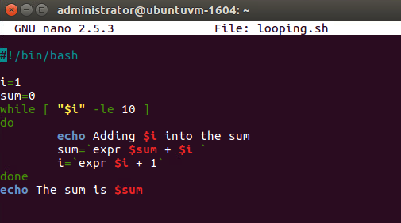
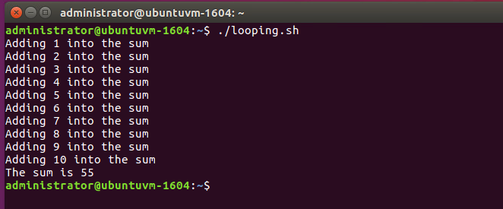
Adding integers from 1 to 10

Slide 58
Until loops
The syntax and usage is almost identical to the while-loops.
Except that the block is executed until the test condition is satisfied, which is the opposite of the effect of test condition in while loops.
Note: You can think of until as equivalent to not_while
Syntax: until test
do
commands ….
done

Slide 59
Switch/Case Logic
The switch logic structure simplifies the selection of a match when you have a list of choices
It allows your program to perform one of many actions, depending upon the value of a variable

Slide 60
Case Statements
The case structure compares a string ‘usually contained in a variable’ to one or more patterns and executes a block of code associated with the matching pattern. Matching-tests start with the first pattern and the subsequent patterns are tested only if no match is not found so far.
case argument in
pattern 1) execute this command
and this
and this;;
pattern 2) execute this command
and this
and this;;
esac

Slide 61
Functions
Functions are a way of grouping together commands so that they can later be executed via a single reference to their name. If the same set of instructions have to be repeated in more than one part of the code, this will save a lot of coding and also reduce possibility of typing errors.
SYNTAX:
functionname()
{
block of commands
}

Slide 62
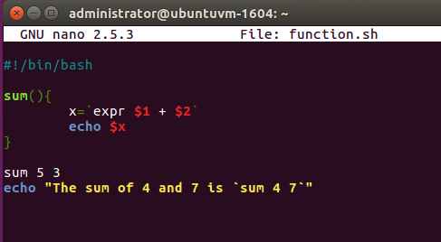
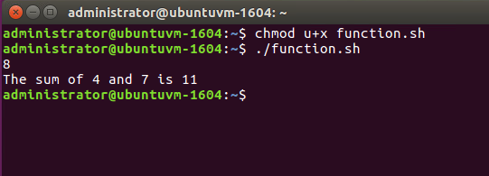
Functions

Slide 63
Take-home message
Shell script is a high-level language that must be converted into a low-level (machine) language by UNIX Shell before the computer can execute it
UNIX shell scripts, created with the vi or other text editor, contain two key ingredients: a selection of UNIX commands glued together by Shell programming syntax
UNIX/Linux shells are derived from the UNIX Bourne, Korn, and C/TCSH shells
UNIX keeps three types of variables:
Configuration; environmental; local
The shell supports numerous operators, including many for performing arithmetic operations
The logic structures supported by the shell are sequential, decision, looping, and case

Slide 64
To Script or Not to Script
Pros
File processing
Glue together compelling, customized testing utilities
Create powerful, tailor-made manufacturing tools
Cross-platform support
Custom testing and debugging
Cons
Performance slowdown
Accurate scientific computing

Slide 65
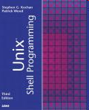
References
Class Shell Scripting
http://oreilly.com/catalog/9780596005955/
LINUX Shell Scripting With Bash
http://ebooks.ebookmall.com/title/linux-shell-scripting-with-bash-burtch-ebooks.htm
Shell Script in C Shell
http://www.grymoire.com/Unix/CshTop10.txt
Linux Shell Scripting Tutorial
http://www.freeos.com/guides/lsst/
Bash Shell Programming in Linux
http://www.arachnoid.com/linux/shell_programming.html
Advanced Bash-Scripting Guide
http://tldp.org/LDP/abs/html/
Unix Shell Programming
http://ebooks.ebookmall.com/title/unix-shell-programming-kochan-wood-ebooks.htm

