Slide 1
IT4893 Internet of Things: Applications and Security
Module 4 Data Acquisition
Compiled by Dr. Shirley Tian
Department of Information Technology

Slide 2
Introduction
Machine to machine (M2M) refers to technologies that allow both wireless and wired systems to communicate with other devices of the same ability.
Regardless of the type of machine or data, information usually flows in the same general way -- from a machine over a network, and then through a gateway to a system where it can be reviewed and acted on.

Slide 3
M2M uses a device (e.g., a sensor or meter) to capture an event (e.g., temperature, inventory level, etc.), which is relayed through a network (wireless, wired or hybrid) to an application (software program) that translates the captured event into meaningful information or intelligent information.

Slide 4
IoT
The basic idea of this concept is the pervasive presence around us of a variety of things or objects – such as Radio-Frequency Identification (RFID) tags, sensors, actuators, mobile phones, etc. – which, through unique addressing schemes, are able to interact with each other and cooperate with their neighbors to reach common goals.

Slide 5
Devices to acquire the data
One of the biggest breakthroughs of the Internet of Things is making the physical world and information world together.
Sensors play a very important role to bridge the gap between the physical world and information world. Sensors collect data from their environment, generating information raising awareness about context.

Slide 6
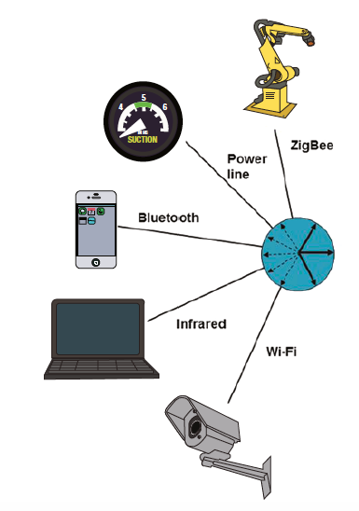
A wide variety of end device physical interfaces may be accommodated, all
communicating via chirp protocols. Propagator nodes will vary in the type and number of interfaces provided based on user requirements

Slide 7
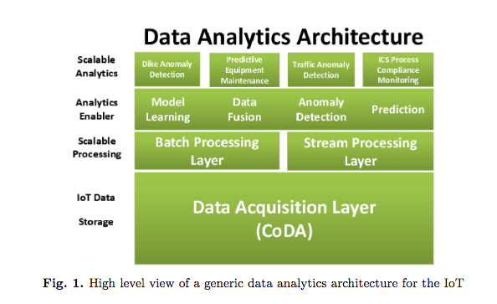
IoT Data Analytics Architecture

Slide 8
The IoT is composed of multiple objects, or things, that can generate data constantly.
Simple data collection services would already benefit from such a data acquisition architecture; however, services that embody an advanced analytic function, e.g., machine learning, would benefit the most.

Slide 10
The four layers are things; local data models; model management and distribution; and finally the global data models.
Layer Things - actual data generated by each individual set of things
Layer Local data model - responsible for representing data from the lower layer
Layer is a composition of two components, a component for managing the generated local data models and another component for distributing the models.
The global data layer, encompasses a collection of all data models that is easily accessible by users or service providers.

Slide 11
Security Challenges
Two main security problems:
IoT is the absence of centralized points of service
The existence of numerous low-resource devices with power limitations.
Resource intensive mechanisms such as asymmetric cryptography or centralized architectures, like PKI infrastructures, are limited.

Slide 12
Not all things require strong security properties, more lightweight symmetric cryptographic techniques can be utilized
Sophisticated trust models need to be built to enable the deployment of access control limitations between owners and things.
It is necessary to distinguish in the layer of things who are the owners of a thing and manage the respective access control list of each.

Slide 13
Privacy and Trust
In general and especially in the IoT, privacy is more than just keeping personal information confidential.
Identity privacy refers to disclosing a user’s identity if and only if needed and keep it secret otherwise.
Query privacy refers to data retrieval without revealing to the sender (or any other party) which data was received.
Location privacy means hiding a user’s location to the reasonable extent whenever possible.
Footprint privacy aims at minimizing a user’s linkable (meta) data volume.

Slide 14
Privacy and Trust
Trust is in general, especially in the context of IoT, more than just relying on third parties.
Device trust refers to the user’s confidence to interact with reliable sensors, as well as assessing the accuracy of the produced data. Sensors that are not handled according to specifications have the risk of producing inconsistent or wrong data.
Processing trust reflects the need to deal with correct and meaningful data.
Connection trust embodies the desire to exchange data only with the intended partners.
System trust refers to the ability of using the interaction Between things to confidently accomplish complex tasks.

