Slide 1
IT4893 Internet of Things: Applications and Security
Module 5 Intelligence Information Processing
Compiled by Dr. Shirley Tian
Department of Information Technology

Slide 2
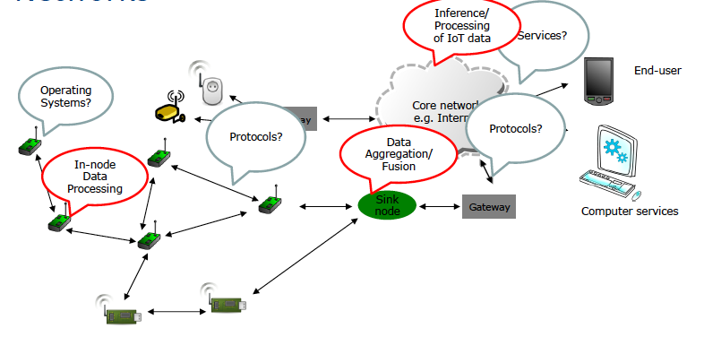
Wireless Sensor Networks
The networks typically run Low Power Devices
Consist of one or more sensors, could be different type of sensors (or actuators)

Slide 3
Key Characteristics of IoT devices
Often inexpensive sensors (actuators) equipped with a radio transceiver for various applications, typically low data rate ~ 10-250 kbps.
Deployed in large numbers
The sensors should coordinate to perform the desired task.
The acquired information (periodic or event-based) is reported back to the information processing center (or some cases in-network processing is required)
Solutions are often application-dependent.

Slide 4
Beyond Conventional Sensors
Human as a sensor (citizen sensors)
e.g. tweeting real world data and/or events
Software sensors
e.g. Software agents/services generating/representing data

Slide 5
The benefits of data processing in IoT
Turn 12 terabytes of Tweets created each day into sentiment analysis related to different events/occurrences or relate them to products and services.
Convert (billions of) smart meter readings to better predict and balance power consumption.
Analyze thousands of traffic, pollution, weather, congestion, public transport and event sensory data to provide better traffic and smart city management.
Monitor patients, elderly care and much more…

Slide 6
The benefits of data processing in IoT
Requires:
Real-time, reliable, efficient (for low power and resource limited nodes), and scalable solution.

Slide 7
IoT Data Access
Publish/Subscribe (long-term/short-term)
Ad-hoc query
The typical types of data request for sensory data”
Query based on
ID (resource/service) – for known resources
Location
Type
Time
An entity of interest
Complex data types

Slide 8
Sensor Data
The sensory data represents physical world observation and measurement and requires time and location and other descriptive attributes to make the data more meaningful.
For example, a temperature value of 15 degree will be more meaningful when it is described with spatial (e.g. Guildford city center) and temporal (e.g. 8:15AM GMT, 21-03-2013), and unit (e.g. Celsius) attributes.
The sensory data can also include other detailed meta-data that describe quality or device related attributes (e.g. Precision, Accuracy).

Slide 9
Sensor Data
15, C, 08:15, 51.243057, -0.589444

Slide 10
Data Processing and Interpretation
Intelligent Processing and Interpretation of data
Meta-data enhancement, annotation and semantically described IoT data

Slide 11
IoT Data Challenges
Interoperability: various data in different formats, from different sources (and different qualities)
Discovery: finding appropriate device and data sources
Access: Availability and (open) access to resources and data
Search: querying for data
Integration: dealing with heterogeneous device, networks and data
Interpretation: translating data to knowledge usable by people and applications
Scalability: dealing with large number of devices and myriad of data and computational complexity of interpreting the data.

Slide 12
Comparing IoT data stream with conventional multimedia streams
Attributes | IoT Data | Conventional Data Streams
Size | Often very small; some IoT data can be a real number and unit of measurement; the meta-data is usually significantly larger than the data itself | Usually much larger than IoT data (video data)
Location dependency | Most of the time location dependent | Normally not location dependent
Time dependency | Time dependent; need to support various queries related to temporal attributes | Normally not time dependent
Life span | Usually short lived or transient | Long lived
Number | Often very large | Usually smaller than IoT data items
Persistency | Some of the data needs to be archived | Usually persistent
Resolution | Names created from meta-data for resolution could be longer than conventional data (taking into account temporal and spatial dimensions) | Resolution is usually based on names

Slide 13
References
Protocols and Architectures for Wireless Sensor Networks, Protocols and Architectures for Wireless Sensor Networks Holger Karl, Andreas Willig, chapter 3, Wiley, 2005 .
P. Barnaghi, W. Wang, L. Dong, C. Wang, "A Linked-data Model for Semantic Sensor Streams", in the Proc. of IEEE International Conference on Internet of Things (iThings 2013), August 2013.
Internet of Things- Intelligent Data Processing, University of Surrey

